Slide 1
Chapter-11
Dyestuff
1
  Introduction to dyes
Nature expresses itself in a wide spectrum of colours all around us.
The alchemy of colour started from an early time.
Natural dyeing had developed essentially as a folk art. However, in recent times the dyeing technique is interpreted on sound scientific principles, and the interaction between the dye and the dyed material is well understood.
From our recent work, we have tried to explain the nature of bonding in certain dyes by looking at their structures and using metal ions for chelating.

Slide 2
WHAT IS A DYE?
2
A dye is a soluble, colored substance that has an affinity for a fiber or other substance, meaning that it will adhere to the surface. (In contrast, a pigment is insoluble an usually has no affinity) .
Dyes can be made from plant, animal, and mineral substances.
HISTORY OF NATURAL AND SYNTHETIC DYES
In the beginning, all dyes were made from natural substances.
The oldest known dyed articles date to about 36,000 years
By about 5,000 years ago, dyes were widely used.

Slide 3
Throughout history, colored fabrics have signified wealth, status, occupation, etc. Like spices, dyestuffs are light, easy to ship, and often non-perishable, so they were valued and expensive trade goods, along with other substances used in the dyeing process.
Natural dyestuffs produce beautiful colors, but they may be laborious to collect or process and can vary widely from batch to batch. Also, natural dyes only work on natural fibers or fibers derived from cellulose–wool, cotton, silk, ramie, hemp, wood, rayon, etc.

Slide 4
They will not dye man-made fibers such as polyester, vinyl, spandex, and so on.
The first synthetic dye was produced in 1856, and since the Industrial Revolution, chemists have developed thousands more.
Synthetic dyes are cheap to produce, do not vary from batch to batch, and will dye a wide range of substances. However, some of them may be dangerous to handle. So why we use natural dyes? For beauty–the colors have a depth that synthetics often cannot match, and they all seem to go together.

Slide 5
Fastness refers to the permanence of a dye. A light-fast dye will not fade with exposure to sun, and a wash-fast dye will not fade with laundering.
Dyestuff–This is the plant material being used.
Depending on the plant, the dye may be found in the roots, leaves, fruit, flowers, stems, and/or wood. Sometimes one plant can produce a whole range of colors.
Hundreds of “recipes” exist. The usual ratio is one pound of plant material to one pound of fiber.
Mordant–A mordant is a chemical which helps the dye molecules adhere to the fiber and stay there. That is, they help dyes be more fast.
Many are metal salts and were discovered when dyers noticed that dyepots made of different materials yielded different colors.
.

Slide 6
Sources of Natural Dyes
There are primarily four sources from which natural dyes are available.
A. Specialized plant and animal sources:
Many plants and some animals have been identified as potentially rich in natural dye contents, and some of them have been used for natural dyeing for quite some time.
Various parts of plants like roots, stems, barks, leaves, fruits and seeds may contain coloring matter which can be exploited.
Normally natural dyes are extracted from the roots, stems, leaves, flowers, fruits of various plants, dried bodies of certain insects and minerals.
Some plants may have more than one colour depending upon which part of the plant one uses.
The shade of the colour a plant produces will vary according to time of the year the plant is picked, how it was grown, soil conditions, etc.
The minerals in the water used in a dye bath can also alter the colour. Some natural dyes contain natural mordants.

Slide 7
B. By-products (especially lac dye):
The lac industry gives lac dye as a by-product, which is extracted from the effluent.
Similarly from Cassia tora, used in gum manufacturing, a brown dye is obtained as a by-product.
C. Chemical synthesis:
This involves synthesis of dyes with mo­lecular structures identical to those of natural dyes. D.Tissue or cell culture by DNA transfer biotechnology:
Certain fungi such as Drechslera and Trichoderma produce anthraquinone derivatives as secondary metabolites.
As anthraquinones are a very important class of dyes, exploiting the fungi would be advantageous over their chemical synthesis.
If genetic modifica­tions can be achieved, it is possible to develop fungi that produce substituted anthraquinones.

Slide 8
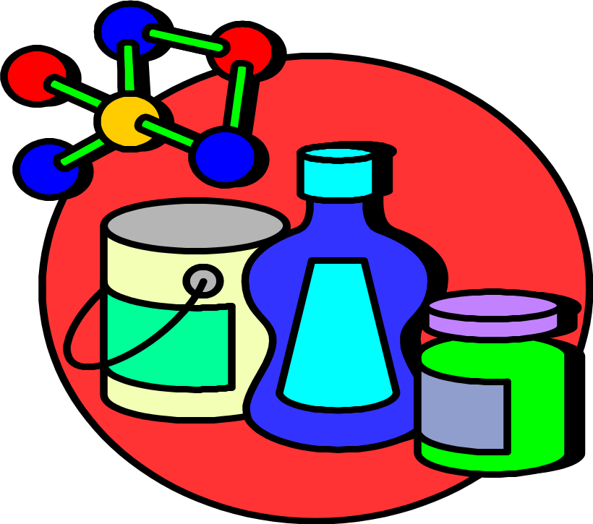
Classification of Dyes
No single class of dye can dye all fibres.
A specific class of dye can only be applied to a given type of textile fibre.
I. Dye for Cellulosic Fibres:
Direct Dyes
Azoic Dyes
Reactive Dyes
Sulphur dyes
Vat Dyes

Slide 9
Classification of dyes
Dye Class | General description | Main application
Direct | Simple application; cheap; complete colour range; moderate colour fastness but can be improved by after-treatment with copper salts & cationic fixing agents. | Mainly used for cellulosic fibres; can also be applied on rayon, silk & wool.

Slide 10
Direct Dyes
Direct dyes for Cotton, Viscose, Silk & Nylon
Easy to dye - require only cooking salt & very hot to boiling water.
Dyes have a good light fastness but only moderate wash fastness .
It is possible to improve on wash fastness by after-treatment of dyed article with dye-fixing agent.
These dyes are principally used for “not so expansive” products or product with fewer washes such as T-shirts, curtains & theatre productions.

Slide 11
Classification of dyes
Dye Class | General description | Main application
Azoic (Naphthol) | Complicated application; limited colour range (red, orange, navy among the best); bright shade at moderate cost; generally good wet fastness but moderate to poor dry cleaning & rubbing fastness; also called naphthol dye due to the use of naphthol, or ice colour because of the usage of ice during application. | Mainly applied on cellulosic fibres, especially on brilliant red shade.

Slide 12
AZOIC DYES
The word 'Azoic' is the distinguishing name given to insoluble azo dyes that are not applied directly as dyes, but are actually produced within the fibre itself.
This is done with impregnating the fibre with one component of the dye, followed by treatment in another component, thus forming the dye within the fibre.
The formation of this insoluble dye within the fabric makes it very fast to washing.
The deposition of the dye on the surface of the fibre produces poor rub fastness, but once the loose dye is removed by boiling the fabric in soap, the dyeing becomes one of the fastest available.

Slide 13
AZOIC DYES
Normally it is dyed in cold for all natural fibers
Naphtol dyes are not sold in the form of a "finished dye" but in form of their components (Insoluble azo base & fast colour coupling compound) which combine on the fibre to produce a water insoluble azo dye of exceptional fastness properties.

Slide 14
Classification of dyes
Dye Class | General description | Main application
Vat | Difficult to apply (requires reduction treatment to make soluble in water & oxidation to resume insoluble state after dyeing); most expensive; incomplete colour range (strong in blue & green but weak in brilliant red); good all round fastness except indigo & sulphurised vat species; tending to decrease in popularity due to increasing use of reactive dyes. | Commonly used for high quality cotton goods, e.g. towel; specially used in the dyeing of denim fabric.

Slide 15
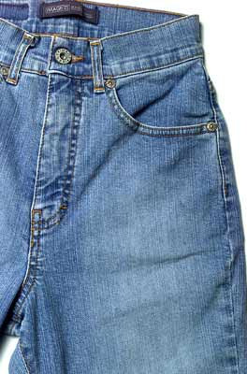
VAT DYES
INDIGO, probably the oldest dye known to man, is one of the most important members of this group.
Natural indigo extracted from the plant'Indigofera tinctorie' was used by the Egyptians in 200 BC.
The first synthetic indigo was introduced to the textile trade in 1897 & had the effect of completely replacing the natural product.
Although the vat dyes may be divided into 3 chemical groups, they are similar in that they are insoluble in water & become water soluble when reduced in the presence of an alkali.
After dyeing, the fabric is oxidized & the dye again becomes water insoluble.
Because of the time consuming & costly procedure in reducing vat dye into a water-soluble complex, dye manufacturers have produced a stabilized water-soluble vat dye.

Slide 16
VAT DYES
This dye can be applied to cotton & viscose rayon by the methods used by applying direct cotton dyes.
After the dyeing, a simple treatment restores the vat dye to its normal insoluble state.
Solubilized vat dyes have an affinity for cellulose & animal fibres.
VAT DYES - USE:
Vat dyes are used in cotton dyeing where high wash & boil fastness required.
Because of the high alkali concentration in the dye bath, pure vat dyes cannot be used on animal fibres, (wool, natural silk, & various hairs).
Bright red is absent in vat dye range.
Solubilized vat dyes, not requiring the presence of alkali, can be used for dyeing on animal fibres.
Because they are dyed at low temperatures, they are used in Indonesian batik dyeing for green shades.

Slide 17
Classification of dyes
Dye Class | General description | Main application
Sulphur | Difficult to apply (application similar to vat dyes); cheap particularly for dark shade; incomplete black, navy, khaki & colour range (strong in brown but no bright shade); poor washing & rubbing fastness & sensitive to chlorine; may cause fabric rendering of cellulose upon storage (aging). | Mostly used for heavy cellulosic goods in dark shades.

Slide 18
SULPHUR DYES
The first Sulphur dye was discovered in France in 1873, & further work done by Raymond Videl enabled the manufacture of 'Videl black".
The general disadvantage of the Sulphur dyes that they produce dull shades & lack a red.
The main advantage lays in their cheapness, ease of application & good wash-fastness.
In their normal state, Sulphur dyes are insoluble in water but are readily soluble in the solution of Sodium Sulphide.
In this form they have high affinity to the all cellulose fibres.

Slide 19
SULPHUR DYES - USE:
The use of Sulphur dyes is restricted to dull brown, where a good wash but not boil-fastness is required.
Most Khaki & Navy overalls are dyed with Sulphur dyes.
An outstanding member of this family is Sulphur black.
It dyes all cellulose fibres, but particularly linen & jute, to a lustrous & deep black with excellent wash & light fastness.
Sulphur dyes are dyed from a dye bath containing Sodium Sulphide & common or Glaubers Salt, & are oxidized by airing or with some oxidizing agents (Sodium Bichromate or Hydrogen Peroxide) in a fresh bath.

Slide 20
Classification of dyes
Dye Class | General description | Main application
Reactive | Easy application; moderate price; complete colour range; good fastness due to direct reaction with fibres. | Commonly used for all cellulosic goods especially in knitted fabric batchwise dyeing; selective dyes can also be applied on wool, silk & rayon; increasingly used in printing due to good fastness.

Slide 21
REACTIVE DYES
This is an entirely class of dye introduced to the market in 1956.
They react chemically with the fibre being dyed & if correctly applied, cannot be removed by washing or boiling.
The main feature of the dyestuff is its low affinity to cellulose; therefore large amounts of salt are required to force its deposition on he fabric.
After this has been achieved, addition of alkali causes the deposited dyes to react with the fibre.
Basically there are two types of reactive dyes: the cold dyeing & hot dyeing types.

Slide 22
REACTIVE DYES - USE:
Reactive dyes are used where bright dyeing with high light & wash fastness is required.
Cold dyeing is used extensively in batik work.
Although some reactive dyestuffs have been specially modified to dye wool, their main usage is in dyeing cotton linen & viscose rayon.
Cold water fibre reactive dyes, suitable for dyeing on cotton, silk, jute, rayon & hessian.
Cannot be used on synthetics or fabric that has been coated with resin or drip-dry finish.
Dye for Protein Fibres:
Acid Dyes
Metal-complex Dyes
Chrome Dyes

Slide 23
Classification of dyes
Dye Class | General description | Main application
Acid | Easy application; complete colour range with very good bright shades; fastness properties may vary among individual dyes. | Commonly used for wool, silk & nylon.

Slide 24
ACID DYES
These dyes comprise a large number of dyes used for the dyeing of wool, silk & nylon.
They vary considerably in their basic chemical structure, but have one common feature - they dye from an acid dye bath.
All acid dyes can be grouped in 3 sub groups:
  a. Level dyeing acid dyes
  b. Acid milling dyes
  c. Pre-metalized dyes
a. Level dyeing acid dyes:
These dyes produce bright dyeing.
The main feature is their good leveling properties.
They are dyed from a dye bath containing strong acids (Sulphuric or Formic acid).
These dyes exhibit low wash & light fastness.

Slide 25
ACID DYES
b. Acid milling dyes:
Selected because of their high & light fastness & are extensively used for dyeing woolen fabrics that are subsequently milled.
These dyes require great care in application because uneven dyeings are difficult or impossible to rectify.
The dye bath requires the presence of weak acid (acetic acid) or acid releasing salts (ammonium sulphate or ammonium acetate) from which acid is liberated during dyeing.
c. Pre-metalized dyes
These dyes represent an extension of mordant dyes.
The metal component being already incorporated in the dye during manufacturing process.
Very good light fastness even in pale shades

Slide 26
ACID DYES - USE:
The family of acid dyes is very large & diverse, varying widely in their methods of dyeing, application & end use of the dyed fabric.
A choice of dyes should be made considering sometimes-incompatible factors: - level dyeing, fastness, brightness & ease of application.
Care must be taken to use the appropriate method as prescribed for a given dye.
A number of acid dyes are also used to dye nylon.
ACID DYES for Wool, Nylon & Silk
Selection of milling & pre-metallised dyes.
Dyeing at boil with addition of Acetic Acid. Bright strong colours. Mixes of primary colours (*) produce large range of tertiary colours. Dyes have very high light & wash fastness.

Slide 27
Classification of dyes
Dye Class | General description | Main application
Metal-complex | Relatively difficult to apply; expensive; complete colour range but duller shade than acid dyes; good fastness due to high molecular size & metal complex structure. | Mainly used for wool & Nylon.

Slide 28
Classification of dyes
Dye Class | General description | Main application
Chrome Mordant | Complicated application; expensive; complete colour range but very dull shade; good all round fastness. | Mainly used for wool products especially for the end use of carpet.

Slide 29
Classification of dyes
Dye Class | General description | Main application
Disperse | Require skill in application (either by carrier or under high temperature); moderate price; complete colour range; limited solubility in water (normally dispersed in water for application); good fastness after reduction clearing treatment; sublimation property. | Mostly used for polyester & acetate; can also be applied on nylon & Acrylic.

Slide 30
II.Dye for Other Fibres:
A. Disperse Dyes for Polyester, Acetate
B. Cationic Dyes for Acrylic
A. Disperse dyes
The introduction of a new regenerated cellulose acetate fibre in 1920 led to the necessity to develop an entirely new range of dyes.
It was found that acetate (or Celanese) fibre had hardly any affinity for water-soluble dyes.
A new dyeing principle was introduced: dyeing with water dispersed coloured organic substances.
These finely coloured particles are applied in aqueous dispersion to the acetate material & actually dissolved in the fibres.
Disperse dyes use: Basically developed for dyeing of acetate fibres, Disperse dyes are also used for dyeing of polyamide (Nylon) & acrylic (Orlon & Acrylan) fibres. With the addition of 'carriers' or swelling agents these dyes are also used in dyeing of Polyester (Terylene, Dacron, etc.)

Slide 31
Classification of dyes
Dye Class | General description | Main application
Basic (Cationic) | Careful application required to prevent unlevel dyeing & adverse effect in hand-feel; complete colour range with very good brilliant shades. | Mainly used for acrylic.

Slide 32
B. Cationic & basic dyes
MAUVENE, the first to be discovered by Perkin, was a basic dye & most of the dyes which followed, including magenta, malachite green & crystal violet, were of the same type.
“Basic dyes” dye wool & silk from a dye bath containing acid but dye cotton fibres only in the presence of a mordant usually a metallic salt that increases affinity of the fabric for the dye.
Basic dyes include the most brilliant of all the synthetic dyes known, but unfortunately they have very poor light & wash fastness.

Slide 33
CATIONIC & BASIC DYES - USE:
Basic dyes will dye wool & silk from an acid bath & are used where brightness is of prime consideration.
With the introduction of cotton dyes possessing higher fastness properties their use for dyeing cotton has diminished.
Basic dyes are used extensively for dyeing cut flowers, dried flowers, also dyeing jute sisal, coir & wood (toys).
With the introduction of acrylic fibre a new range of 'modified' basic dyes – “cationic dyes” were perfected for dyeing of this material.

Slide 34
Cationic dyes
Cationic dyes for dyeing acrylic (Acrilan, Courtelle, Orlon) paper, wood & dried flowers.Also used for dyeing silk & silk flowers in very brilliant colours.
Colour Fastness
A good dye must withstand the subsequent treatment (e.g. laundering, dry cleaning, etc.) or environmental wearing (e.g.rubbing,light exposure, etc.).
The degree to which a dyed material can withstand such treatments & wearing is called colour fastness.
No dye or pigment is fast in all colour fastness.
Only a careful selection & formulation of dyes & auxiliaries can result in a desirable dyeing, & conform with the colour fastness requirements.

Slide 35
Thank you ☺

